Slide 1
Unity in action
National Research Nuclear University "MEPhI“
Obninsk Institute for Nuclear Power Engineering (IATE)
Getting to know Unity
Obninsk, Russia Dmitriy Arkhipov 27.12.2020

Slide 2
This presentation covers
■ What makes Unity a great choice
■ Operating the Unity editor
■ Programming in Unity

Slide 3
What is Unity
Unity is a professional-quality game engine targeting a variety of platforms.
Unity has physics simulation, normal maps, screen space ambient occlusion (SSAO), dynamic shadows…and the list goes on.

Slide 4
Unity’s advantages
Unity has two main advantages: an extremely productive visual workflow, and a high degree of cross-platform support.

Slide 5
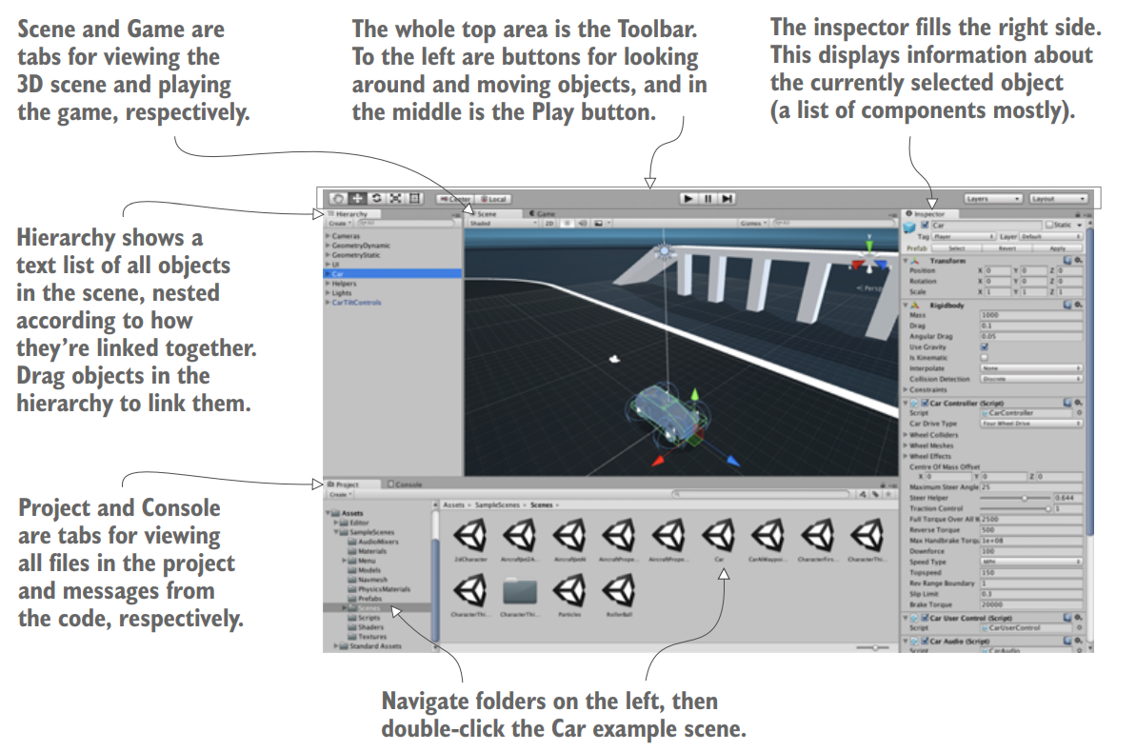
How to use Unity
The interface in Unity is split up into different sections. Each section has a different purpose but all are crucial for the game-building lifecycle

Slide 6
A brief description of interface
Scene view/Game view
The Hierarchy tab
The Project and Console tabs
The most prominent part of the interface is the Scene view in the middle. This is where you can see what the game world looks like and move objects around.
Hierarchy is a list view with the name of every object in the scene, with the names nested together according to their hierarchy linkages in the scene
Project shows all the assets (art, code, and so on) in the project. The Console is the place where messages from the code show up. For example some of these messages will be debug output.

Slide 7
How code runs in Unity
All code execution in Unity starts from code files linked to an object in the scene.
NOTE Unity refers to the code files as scripts, using a definition of “script”

Slide 8
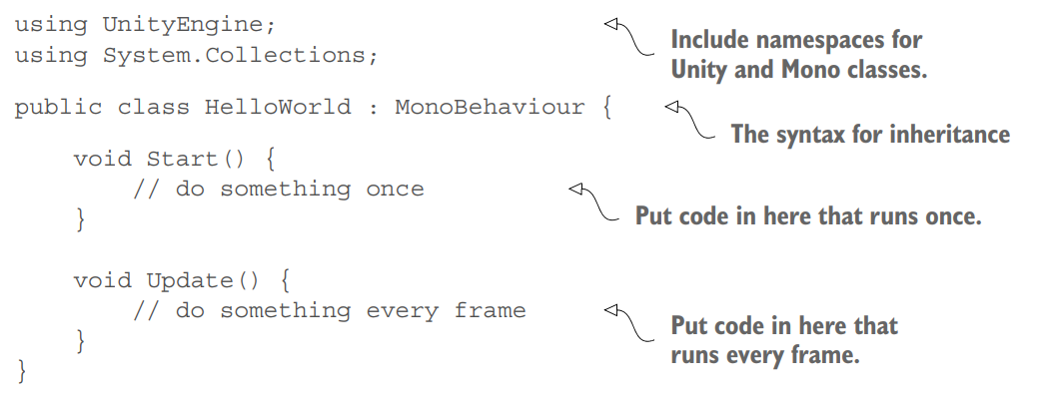
Code template for a basic script component
This is what the file contains when you create a new C# script: the minimal boilerplate code that defines a valid Unity component.

Slide 9
Conclusion
That’s all that I’ve wanted to tell you about basics of Unity.
We covered: ■ Main advantages of Unity
■ Interface of Unity
■ Code files in Unity

Slide 10
Thank you
Dmitriy Arkhipov
Address: 133 Nikitina str., Kaluga city, MN 240003 Phone: 8-(920)-872-99-65
E-mail: arkhipovda20@oiate.ru

